Slide 1


Data Science Assignment
Project Entitled:
"TEXT ANALYSIS AND DATA EXTRACTION
USING PYTHON"
NAME : KAVYA ARUKALA
DATE : 06-08-2024

Slide 2
CONTENTS
Introduction.
Libraries and Initial Setup.
Data Extraction Process.
Text Cleaning.
Text analysis Process.
Saving the Results.
Running the Code.
Conclusion.

Slide 3
INTRODUCTION
Objective:
The project aims to extract article content from provided URLs and perform a text analysis.
2. The goal is to compute various text metrics such as sentiment scores, readability, and word counts.
Overview:
1. The project involves three main steps: data extraction, text cleaning, and text analysis using Python.

Slide 4
LIBRARIES AND INITIAL SETUP
Importing Libraries:
Used Python Libraries: ‘pandas’ , ‘nltk’ , ‘requests’ , ‘BeautifulSoup’ , and more for web scraping and natural language processing.
Loading Data:
Loaded the input Excel file containing URLs and their IDs.
Example: ‘input_df = pd.read_excel('path_to_excel_file'

Slide 5

DATA EXTRACTION PROCESS
URL AND URL_ID Extraction:
Extracted URLs and their corresponding IDs from the Excel file.
Example code:
Article Extraction:
Used ‘BeautifulSoup’ to scrape article titles and texts while ignoring unnecessary content like headers and footers.
Stored each article’s content in a text file named after its URL ID.

Slide 6
TEXT CLEANING
Stopwords Removal:
Cleaned the text by removing common stopwords found in the provided files.
Utilized ‘ntlk’ library for tokenization and stopword removal.
Example: Loaded stopwords from multiple files and applied them to the text.
Text Processing:
Removed punctuation and handled special cases ( e.g., “ed” and “es” endings).

Slide 7
TEXT ANALYSIS PROCESS
Sentiment Analysis:
Calculated Positive and Negative Scores based on predefined dictionaries.
Derived Polarity and Subjectivity Scores from the sentiment analysis.
Formula examples:
Polarity Score: ‘ (Positive Score - Negative Score) / (Total + 0.000001) ’
Subjectivity Score: ‘ (Positive Score + Negative Score) / (Total Words after cleaning) ’
Readability Metrics:
Computed metrics like Average Sentence Length, Complex Word Count, and Fog Index.
Example: ‘Fog Index = 0.4 * (Average Sentence Length + Percentage of Complex Words)’

Slide 8
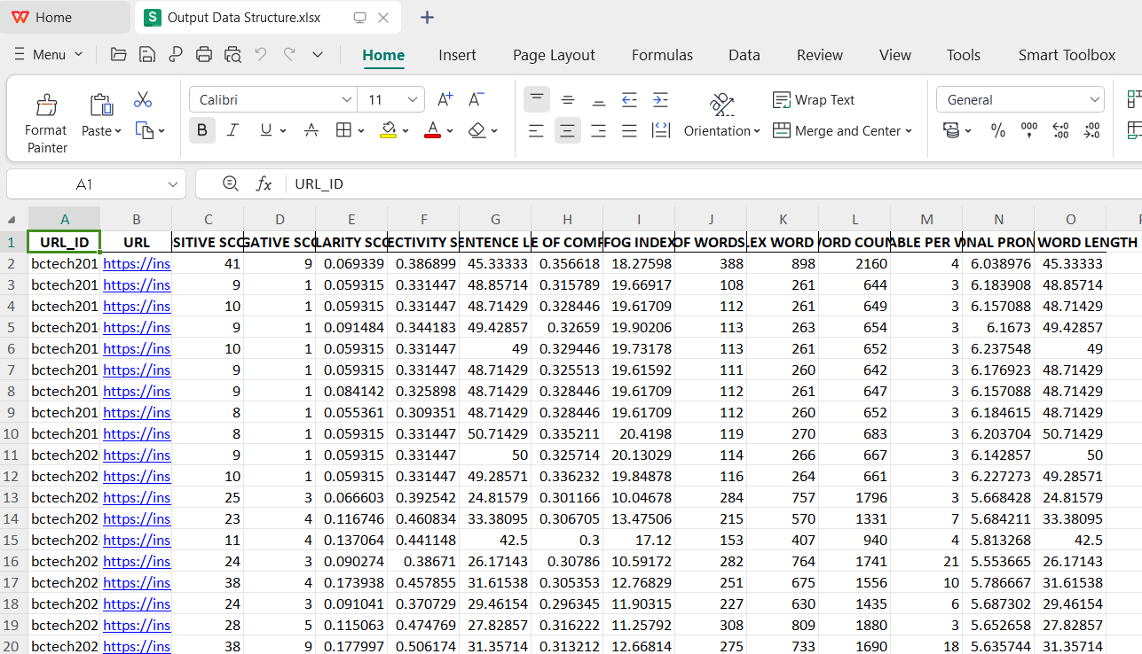
SAVING THE RESULTS
Output Structure:
Saved the Results in a Excel file, following the format provided.
Included all calculated metrics alongside the original input data.
Example Output:

Slide 9
RUNNING THE CODE
Execution Instructions:
To run the Jupyter Notebook, open it and execute all cells sequentially.
Alternatively, convert the notebook to a ‘.py’ file and run it via the command line:
‘python script.py’
Dependencies:
Required libraries: ‘pandas’ , ‘nltk’ , ‘requests’ , ‘BeautifulSoup’ , etc.
Installation: Use ‘pip install’ to install dependencies.

Slide 10
CONCLUSION
Summary:
Successfully extracted and analyzed text data from multiple URLs.
Computed sentiment Scores , readability metrics, and other text analysis variables.
Future Work:
Explore more advanced NLP techniques such as named entity recognition (NER) or Topic modelling.
Improve the scrapping mechanism to handle a broader range of websites.

